Slide 1
Employee Engagement through Targeted Branded Strategy
Expanding Perspectives: A case review of integrated marketing and the application of promotional items
Presented to: ISHMPR Fall Conference
Presented on: October 17, 2019
Presented by: Stephanie Gregory (Northwestern Medicine)
Keri O’Brien Soukup (O’Brien Corporation)

Slide 2
Presentation Summary
Northwestern Medicine Human Resources and O’Brien Corporation deployed a wide variety of impactful employee engagement projects over the course of 2017-2018.
In this presentation, we will review 3 case studies with unique approaches to utilizing promotional products in employee-centric applications.
We will examine best practices for collaborating with your supplier partners in addition to the impact generated through targeted brand experiences.
Key outcomes from each project will be discussed within the context of internal marketing, brand cultivation, and employee engagement.

Slide 3
Learning Objectives
Ideas on how to fully utilize the capabilities of your promotional products vendor as an extension of your team
Creating impactful, branded experiences and events by adding another element for a tactile experience
Driving key behaviors with employees through the utilization of rewards and recognition

Slide 4
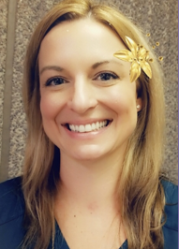
Today’s Presenters
Stephanie Gregory Keri O’Brien Soukup
Northwestern Medicine O’Brien Corporation
Manager, HR Programs Partner

Slide 5
Northwestern Medicine & O’Brien Corporation
History of the Partnership
2006 O’Brien awarded Delnor Print Management program
2008 O’Brien awarded CDH Print Management program
2011 Worked together through extensive print & promotional product launch of Cadence Health brand to internal staff and the community
2014 Continuation of relationship with NM after the Cadence Health integration
2015-Present Prior relationships with Kish Health, Centegra Health System, and Marianjoy Rehab Hospital, all become part of NM.

Slide 6
Case Study #1
Annual Milestone Years of Service
Celebration Dinner

Slide 7
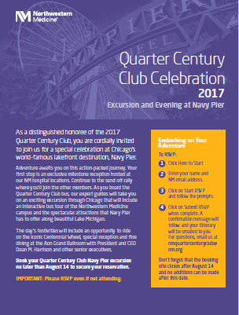
Excursion and Evening at Navy Pier
Quarter Century Club
Quarter Century Club
Employees with 25+ years of service
Recognize employees with 25, 30, 35, 40, 45, and 50-year milestones
Host annual dinner event

Slide 8
Celebration Event Goals
Quarter Century Club
To create one unified event to recognize employees with 25+ years of service throughout the health system.
Traditionally three separate annual dinner events were hosted within each region of Northwestern Medicine.
Partner with O’Brien to carefully select custom branded items to fit the theme of “an excursion and evening at Navy Pier” for over 1,000 honorees, executives and volunteers to make the round-trip bus journey a memorable one.
= Northwestern Medicine Hospital Locations
Note: Does not include the over 120+ outpatient locations

Slide 9
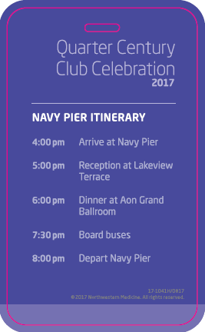
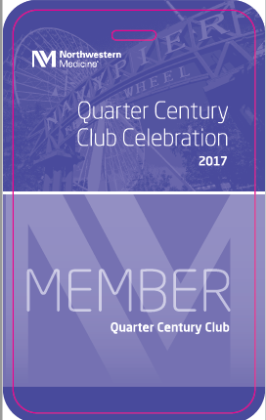
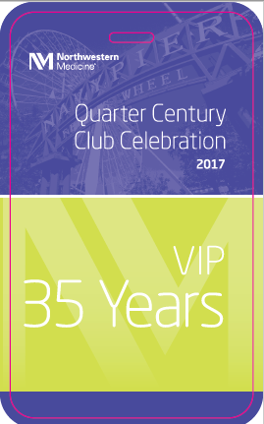
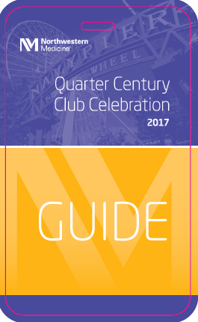
Action Items
Quarter Century Club
We started with creating two-sided custom branded laminated plastic “Access Passes”
The back listed the entire event day itinerary and the front was printed to easily identify 7 different groups based on attendee status
Three separate color combinations of NM custom branded lanyards

Slide 10
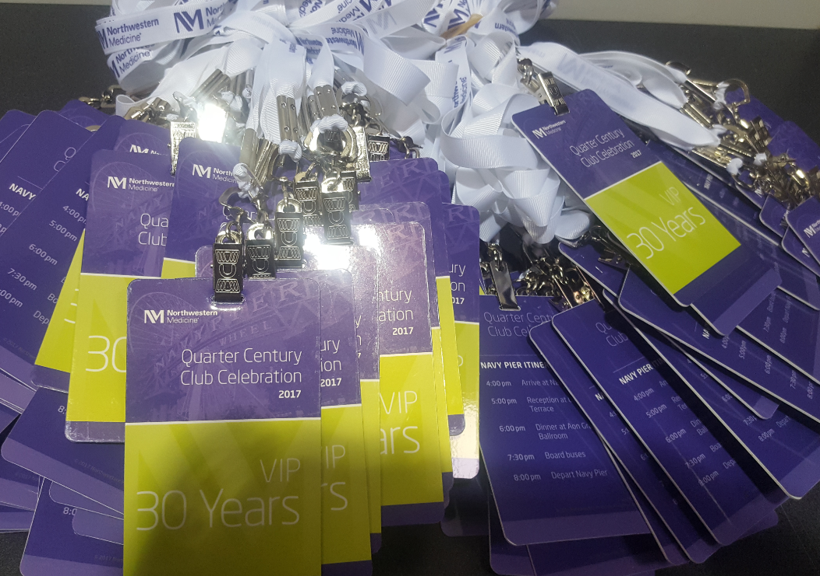
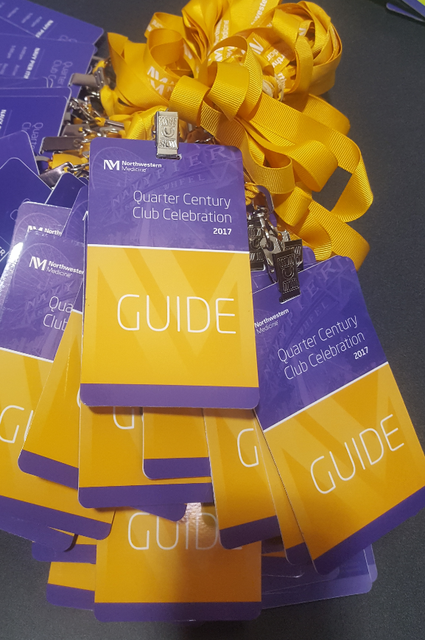
From Concept to Delivery

Slide 11
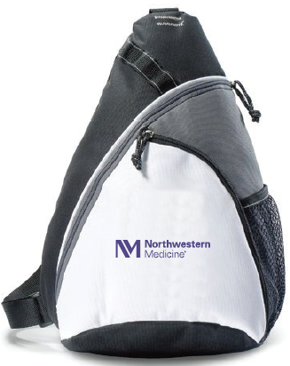
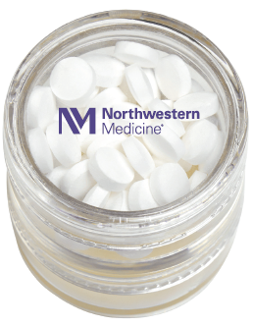
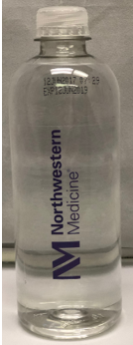
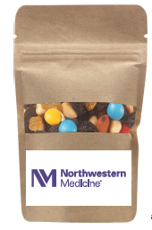
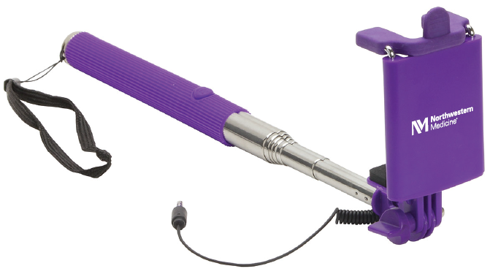
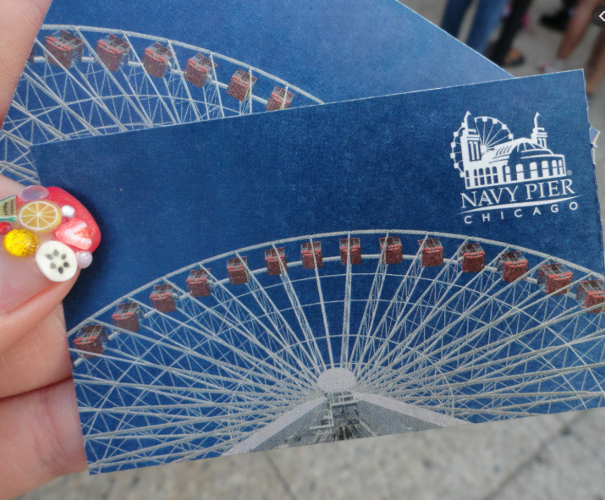
Action Items
Quarter Century Club
Travel Bag
Hikers’ Trail Mix
Custom Branded Bottled Water
Mint and Lip Balm Combo
Hand Sanitizer Spray Pen
Selfie-stick
Navy Pier Ferris Wheel Ticket

Slide 12
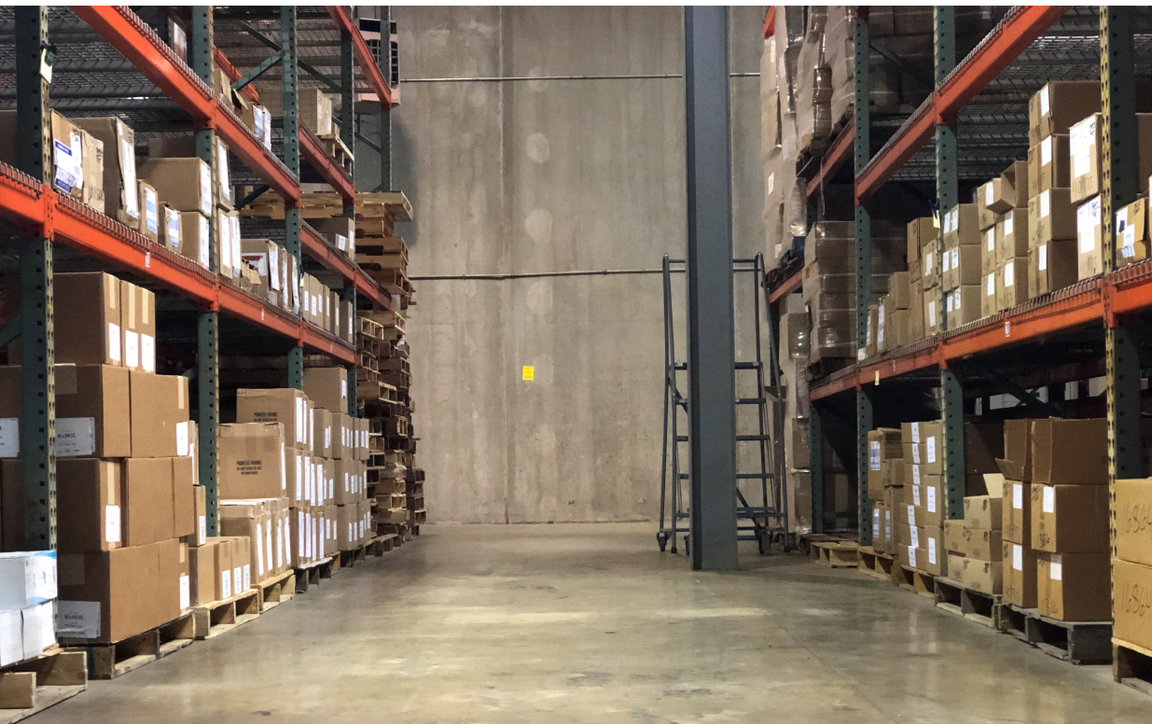
Customized Kit Fulfillment & Distribution
Quarter Century Club
All items received into O’Brien warehouse
Kits were hand assembled and grouped by location with:
Appropriate number of 3 different lanyard styles and 7 different access passes with the cases of bottled water for each group

Slide 13
Challenges
Quarter Century Club
Turnaround
NM team had very narrow time frame in which to have the project completed – under two months from concept to delivery.
Need for fast turn approvals and changes
Communicating quickly back and forth between NM and O’Brien helped us all stay on track with timing and continuing to move all components into each step of the process.

Slide 14
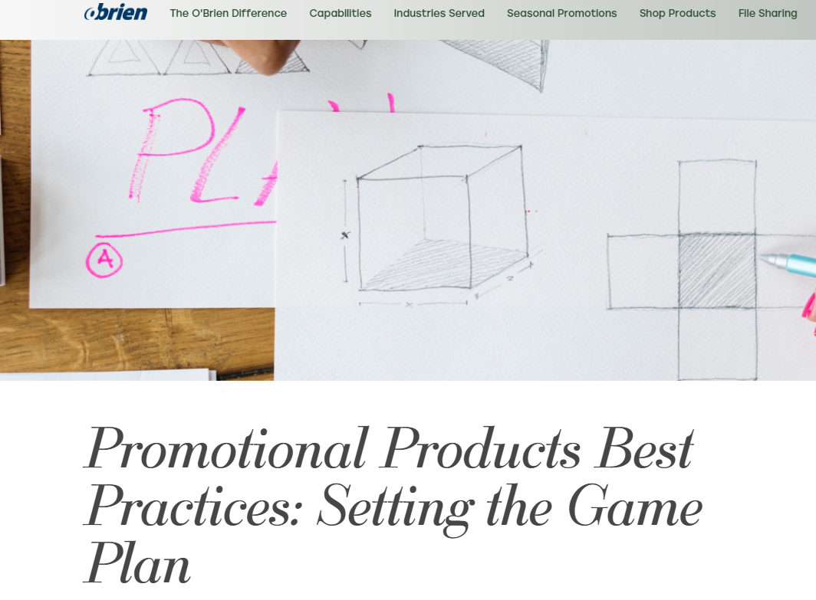
Key Things to Note
Production Timelines with Promotional Items
Product selection
Sample review
Proofing
Production
Shipping
Internal receipt
Distribution

Slide 15
Key Things to Note
Important Considerations for Promotional Items
Desired results
Budget
Quantities
Timelines

Slide 16
Results and Learnings
Northwestern Medicine
Through maintaining close communication with each other, we were able to move quickly to get the items into production and the final distribution plans went off without a hitch.
We all know that happy, engaged employees are one of the best forms of marketing available to an organization.
Although the day was designed to celebrate and recognize the commitment of these valued long-term employees, an added bonus was having onlookers see so many happy employees proudly displaying items with our branding at Navy Pier, one of the busiest locations in Chicago.

Slide 17
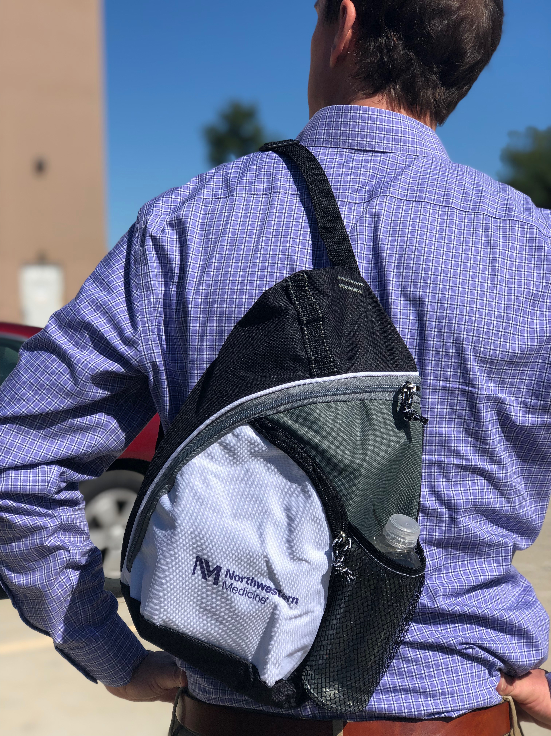
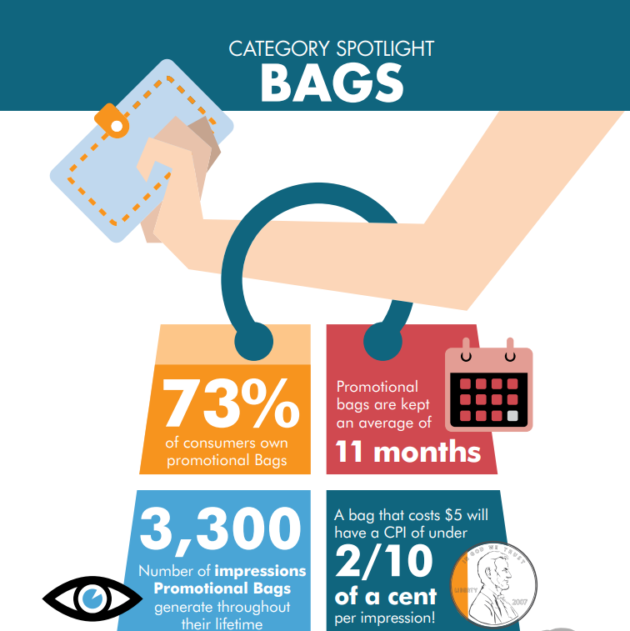
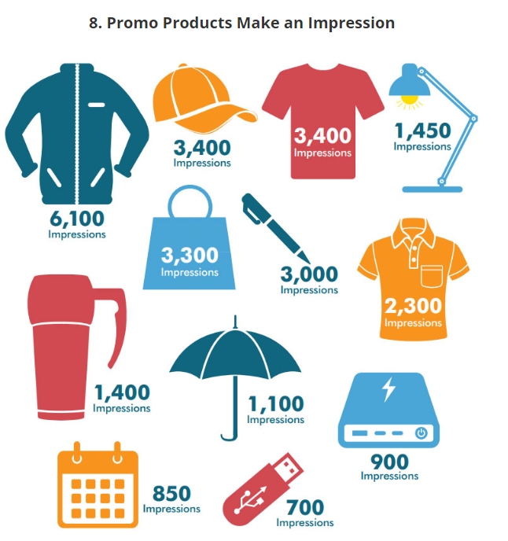
Results and Learnings
O’Brien Corporation
Average # of lifetime impressions of each branded bag is estimated at 3,300*
*According to the Advertising Specialty Institute 2019 Global Ad Impressions Study

Slide 18
Case Study #2
Symbol of NM Pride

Slide 19
Milestone Badge Enhancers
Project Summary
Our employees really enjoy showing off their NM years of service on their milestone badge enhancers that slide directly on ID badges.
When designing, we selected two different background color combinations on the enhancers to elevate the Quarter Century Club members.
The ROI on this program is evident by the thousands of employees who proudly display their loyalty to the NM team.
19

Slide 20
Milestone Badge Enhancers
Summary
Legacy Practice
The Challenge
At NM we traditionally host two milestone celebration events:
Quarter Century Club Dinner
25+ milestones
Milestone Celebration Breakfast
5, 10, 15, and 20-year milestones
Badge enhancers distributed to employees at events
How to distribute enhancers to employees who did not attend events?
Lacked consistent approach
3,500+ enhancers to be distributed throughout the health system
Labor intensive
Not a satisfier to employees who are celebrating a key milestone
20

Slide 21
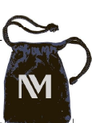
Action
Milestone Badge Enhancers
O’Brien Provided a Sounding Board
The Result
What if:
We mailed the enhancers to the employee’s home?
The enhancers arrived the month of their anniversary?
We included a thank you card from our CEO?
We elevated the packaging?
21

Slide 22
Process
O’Brien Corporation
Forecasted quantities
Fulfillment in house with various components of mailer
Packages labeled and stored in preparation
22

Slide 23
Process
NM Submits monthly list to O’Brien
Pin packages hit mail stream (1 week later)
Employee receives package
O’Brien Corporation
23

Slide 24
Results
Milestone Badge Enhancers
The Challenge
Today
How to distribute enhancers to employees who did not attend events?
Lacked consistent approach
3,500+ enhancers to be distributed throughout the health system
Labor intensive
Not a satisfier to employees who are celebrating a key milestone
Employees receive a milestone enhancer gift package delivered to their home the month of their milestone
Family gets to experience recognition of milestone
Timely recognition is key to engagement
Soon to be automated process in sending monthly mailing lists
Employees reaching out to thank us for their milestone enhancers
24

Slide 25
Case Study #3
NM Celebrate and Share

Slide 26
Add Content

Slide 27
Celebrate and Share
A Holiday Story
NM was looking for a solution to streamline the complexity of organizing the annual employee holiday meal events for employees throughout Northwestern Medicine.
In the past, holiday meal service was held over 3 shifts at each of 8 locations
In addition to the exceptionally complicated planning involved while making sure patient and guest meal service didn’t suffer, the timing of the meal unfortunately meant that many of our nearly 30K employees were not always able to participate and share in our appreciation of their contributions.

Slide 28
Celebrate and Share
A Holiday Story
As another option, NM’s CEO wanted to provide a gift certificate for turkey, ham, or vegetarian option to all 30,000+ employees to either:
Enjoy with family and friends during the holiday season
Pay it forward by giving to someone in need
Return to NM for a large group donation to local charities throughout each region.
Tied in nicely with our NM Celebrate and Share campaign

Slide 29
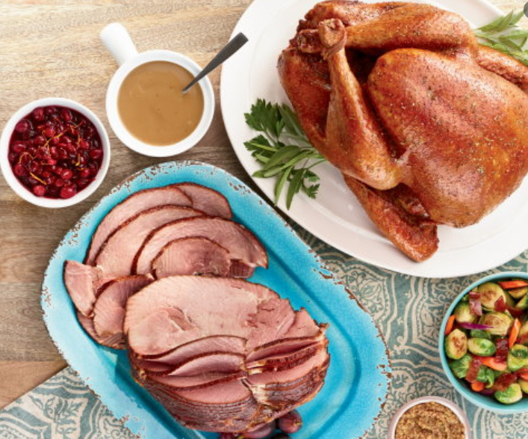
Celebrate and Share
A Holiday Story
NM chose to include turkeys, hams, fruits, veggies and stuffing as their product categories to ensure that all employees would find something that met their dietary needs / preferences.

Slide 30
Celebrate and Share
A Holiday Story
O’Brien partners with a certificate organization with more direct connections with nationwide and local grocers than any other certificate company.

Slide 31
But Wait, There’s More
A Holiday Story – Chapter Two
Town Hall Gifts
Twice a year NM executive host employee town hall sessions
The fall town hall traditionally included a give-away gift to draw attendance
Logistics in delivering gifts to 10 different locations is challenging
Right number of gifts to each location
Space at the dock
Space to hold access inventory
Etc.

Slide 32
What If?
A Holiday Story – Chapter Two
We combined the town hall gift with the holiday gift certificate and mail (do you see a trend?) to each employee’s home in time for the holiday season?
At that point, we reached out to the O’Brien team to discuss their ideas, the logistical reasons for it, and, most importantly, to start brainstorming ideas on how we could partner together to bring this vision to reality.

Slide 33
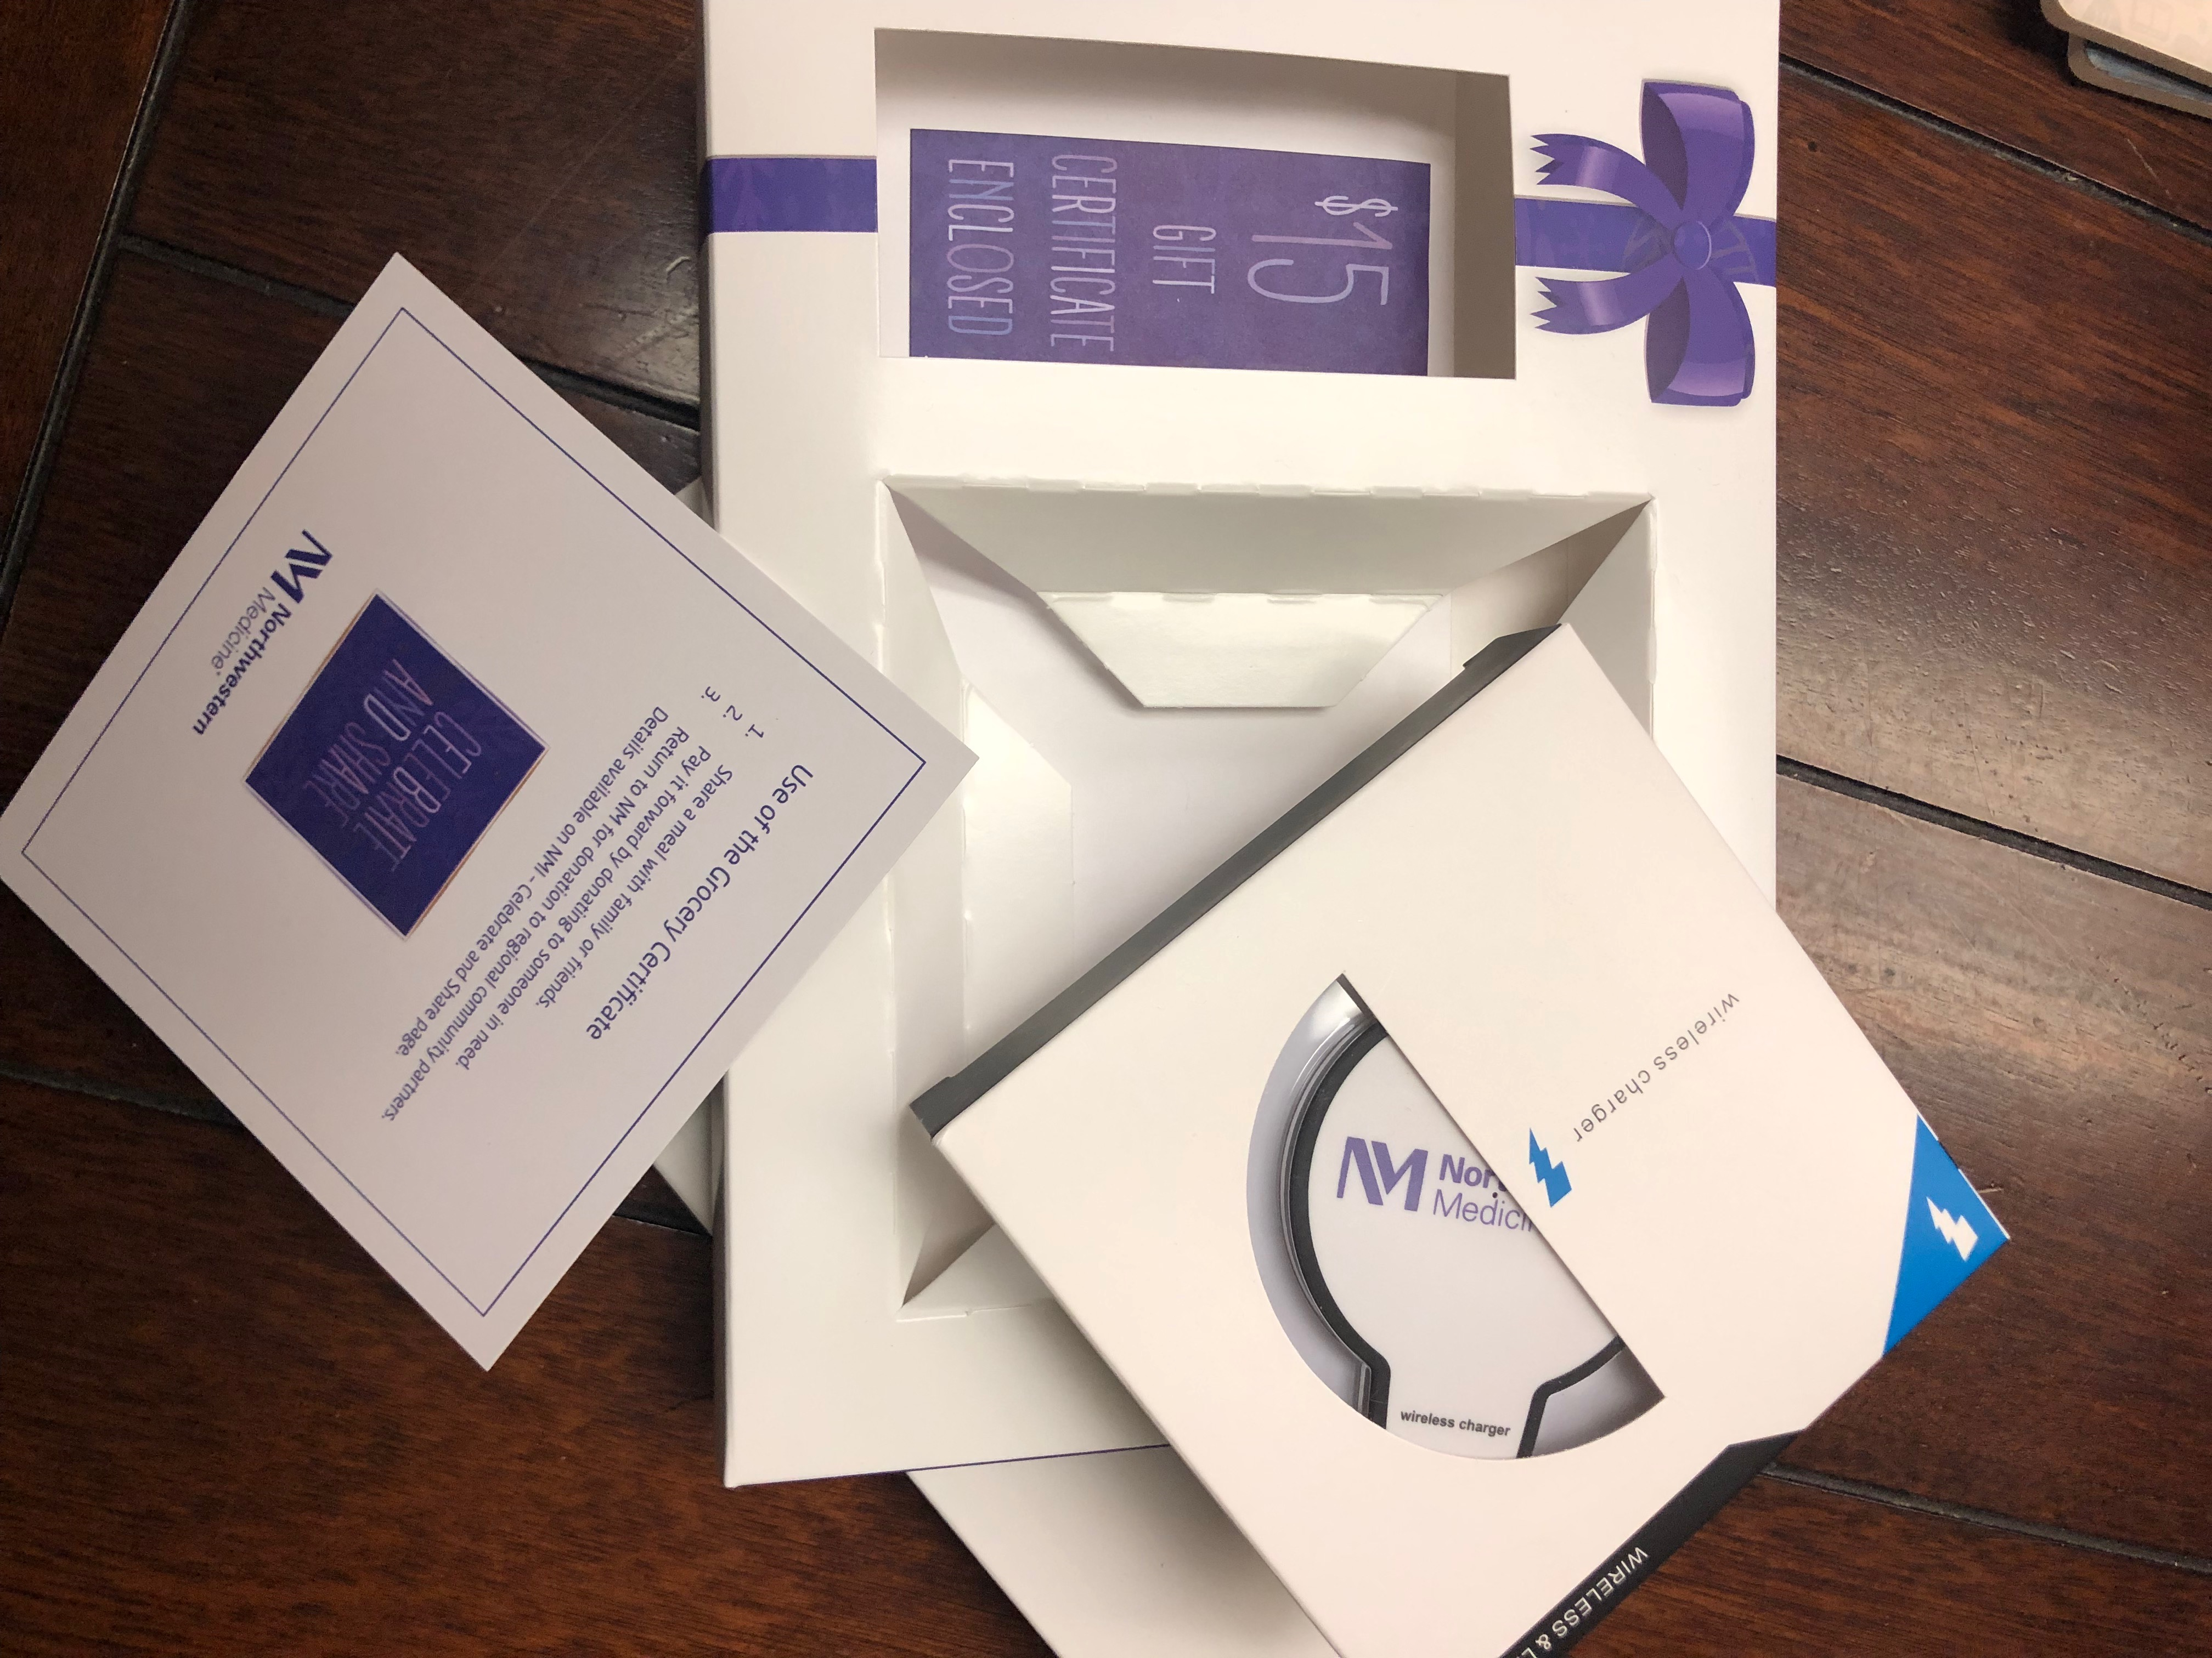
Action
Holiday Gift Mailer

Slide 34
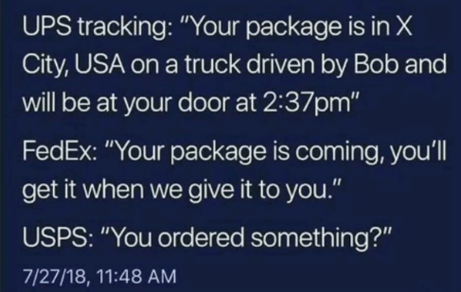
Results
Holiday Gift Mailer
Who doesn’t love to come in under budget?!
Trackable packages
Less than 100 gifts needed to be reshipped as a result of bad addresses, lost or stolen packages.

Slide 35
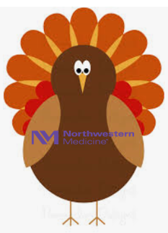
Challenges
Holiday Gift Mailer
Timing was everything on this project.
This entire idea started with a unique conversation between NM to O’Brien---
“Hey, you know we come to you with our projects that require special attention, so can you help us provide turkeys for all of our employees?”
We immediately thought, “We really don’t think we can put your logo on 30,000 turkeys?!”

Slide 36
Challenges
Holiday Gift Mailer
Fraudulent certificates (not from this company or with NM information) on which stores had been burned the prior year.
Handful of human error instances involved where stores attempted to reject them.
24-hour hotline number on the certificate for stores or recipients to call with any questions/concerns.

Slide 37
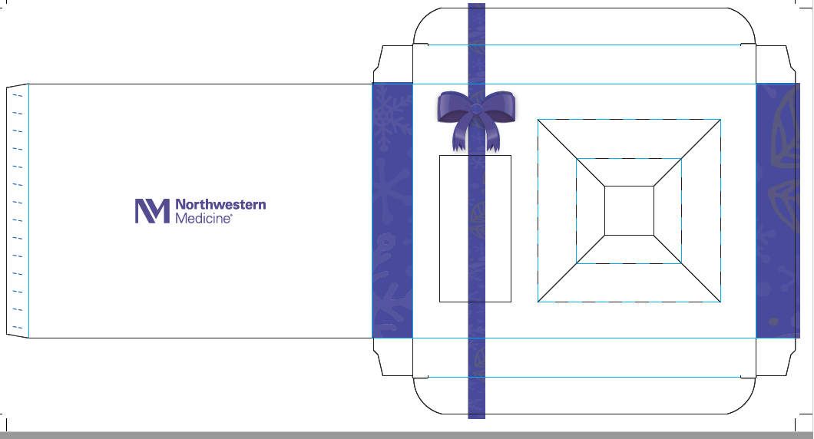
Challenges
Holiday Gift Mailer
Design… Love. That. Bow.
NM wanted to make sure that new hires during the months of November and December weren’t excluded from this gift.

Slide 38
In Summary
Holiday Gift Mailer
The feedback from the workforce was amazing!
Here is one example of employee feedback:
“I just received my NM gift in the mail – and it’s amazing. Beautifully packaged and branded and the message from Dean, along with the suggestion to donate to those in need was an incredibly warm gesture. Wonderful job to you and the team who made this happen! Makes me very proud to work for such an amazing organization.
Personally, I am proud to partner with O’Brien as they are also a wonderful organization.

Slide 39
Questions?

Slide 40
In Conclusion
Share your challenges with your promotional products vendor and better utilize their expertise, resources and ideas!
Create impactful, branded experiences and events in a scalable fashion to provide a consistent experience throughout all areas of the organization.
Drive key behaviors with employees through the utilization of rewards and recognition that touch every employee when possible.
40

Slide 41
Thank You

