Slide 1


MODERN MARKETING IN A DIGITAL WORLD:
Data Driven Decisions & Customer-Centric Strategies

Slide 2


Introductions
Today’s Learning Objectives:
The digital experience
SEO
Patient acquisition/retention
Strategy (KPI baselines & planning)
Analysis (measurement & data-driven decision making)
Erin Minsart
Digital & Marketing Manager
Jamie Malone
Digital Strategist

Slide 3

Background: The Digital Landscape

Slide 4

Background: The Digital Landscape
Look back at 10 years ago. It was 2009.
Let’s take a look at how much our world
has changed due to the emergence of
technology and smartphones:
How many of you shopped on Amazon
or used Amazon Prime?
How many of you have ordered pizza using
a website or app?
How many of you used Google to search for an answer or solution?
How many of you knew who Alexa was?

Slide 5

Background: The Digital Landscape
Today, nearly every aspect of healthcare has evolved due to technology and smartphones.
As we sit here right now, patients are:
Asking their smartphones “Ok, Google, find a doctor or family healthcare clinic near me”
Performing online research about your organization before booking an appointment
Searching for answers about symptoms, procedures, medications and surgeries

Slide 6

Essentially, your patients are the equivalent
of a brand’s “customers.”
It’s time to re-evaluate how they engage
with your healthcare organization.

Slide 7

The Digital Experience

Slide 8


Digital Experience: By the Numbers
60% of organizations considered customer experience to be the number one way to stand out from the competition over the next three years (Digital Onboarding Report 2017)
77% of patients conduct an online search before making an appointment with a physician (Becker’s Hospital Review)

Slide 9
Digital Experience
Healthcare brands can learn from other industries and use data-driven consumer insights to personalize their marketing strategies and enhance the customer experience
Your digital presence has never been so important
Here are a few places to begin:
Be balanced – Heartbeats & the algorithm
Be engaged – Helpful and relevant content
Be relevant - Found at the moment of need
Be top-of-mind – Pull marketing vs. push

Slide 10

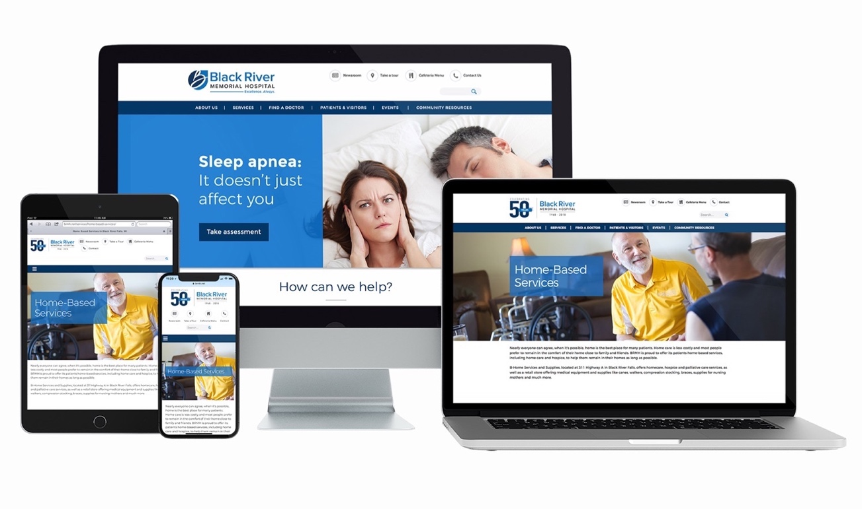
Digital Experience
First impressions matter! Have a well-designed website that:
          Is easy to navigate
          Has current, relevant
          information
Is responsive on any
screen size
Loads quickly
Is ADA compliant

Slide 11
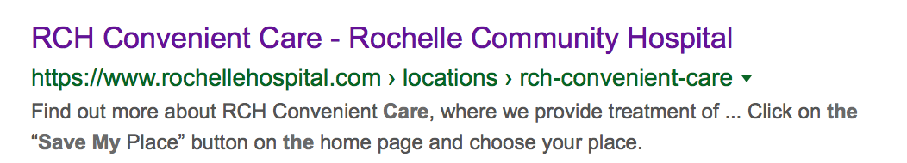
Digital Experience
Key Takeaways
Customers (patients) want a smooth, seamless experience
Patients want a unique, personalized experience
Patients don’t just want a great digital experience; it is an expectation
Examples
Online lab results
Online bill pay
Automated appointment confirmation/reminders (text or email)
Pre & post-procedure instructions sent via email

Slide 12

SEO

Slide 13
SEO: By the Numbers
  89% of consumers turn to a search engine when they’re
  looking to solve their healthcare queries. (Google)
  75% of patients rely on search engines to find a physician
  or treatment center. (Google)
  77% of smartphone owners have used their smartphones
  to find local health services in the past six months.
  79% of them say they’re more likely to revisit
  and/or share a mobile site if it is easy to use. (Google)

Slide 14
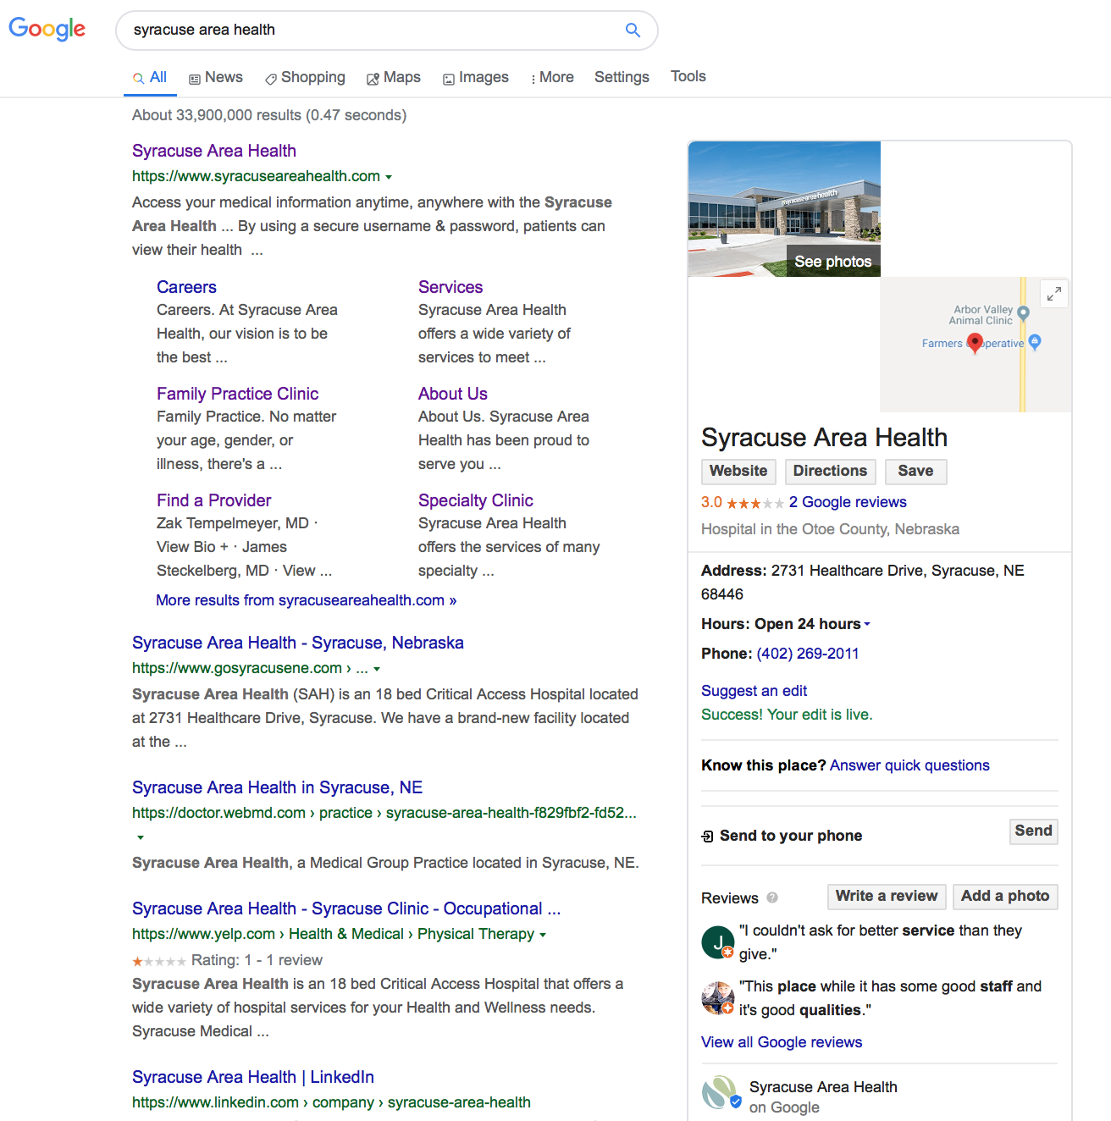
Local SEO
Keep Google Business listings up-to-date
Ensure that location and contact information is accurate on your website
Utilize your local city/municipality within your website’s copy

Slide 15
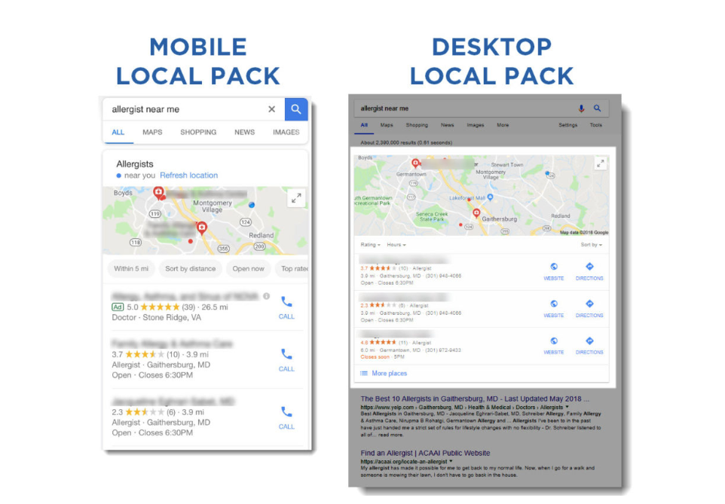
Local Search Results on Google

Slide 16
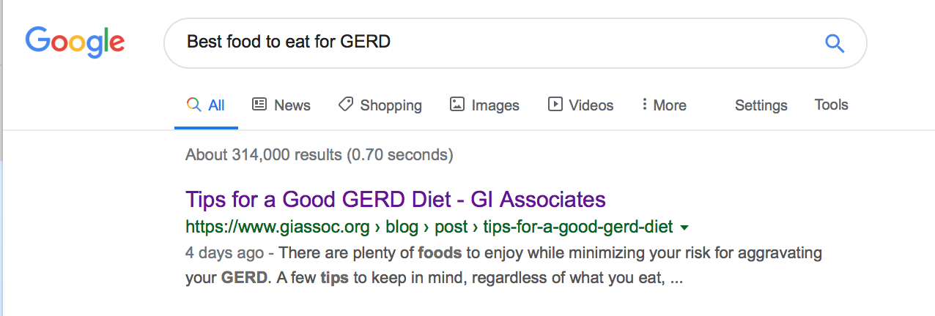
SEO for Information & Research
Information Gathering (Blog)
Blogs are a great way to answer questions to commonly researched symptoms or procedures that patients are looking
up on search engines
Research of your brand (Website Information)
Provider pages
Service level pages
Stats/facts of outcomes
Information about your organization

Slide 17
Website Design: SEO
Ranking Factors
Google has over 100 ranking factors that determine whether your website is deemed as worthy of being listed on the SERP (Search Engine Results Page)
Customer experience factors that impact your
SEO/organic traffic success:
Page speed
Ease of use
Whether or not your website has on-page SEO set up
                - Page titles, meta descriptions, adequate copy, keyword use, etc.
Whether or not your website is indexed and has a sitemap

Slide 18
Ranking Factors
Social 3.5%
Reviews 6.5%
User Personalization 7.3%
Links 27.97%
Citations 8.4%
Google My Business 8.9%
On-site 26%
Use Behavior 11.5%

Slide 19

Patient Acquisition/Retention

Slide 20
Patient Acquisition/Retention
The more you understand your patients and their nuances, the more you can customize their interaction with your organization
Then, you are able to effectively match your marketing messages to their personal preferences
You can deliver relevant information at the right time
When your patients feel taken care of as individuals, your organization will be top-of-mind the next time they need healthcare services

Slide 21


Patient Acquisition/Retention
Imagine the default cliché of the family with 2.5 children,
a golden retriever and a white picket fence
How many patients actually fit into the images or “boxes” we assume they fit in to?

Slide 22
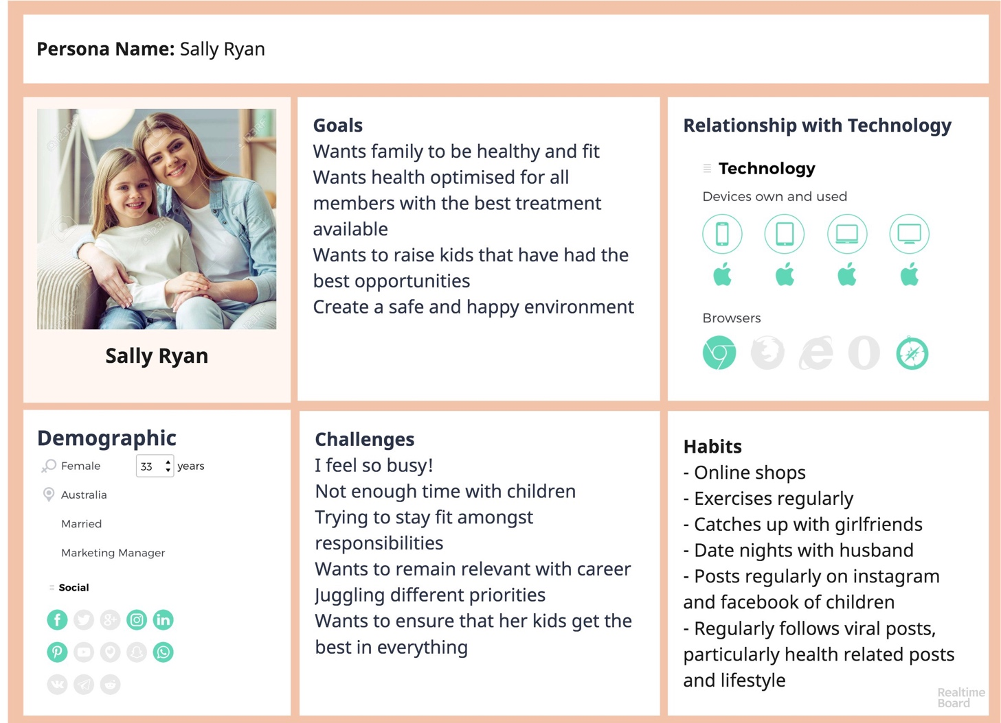
Patient Personas
Susan Livewell
Susan Livewell

Slide 23
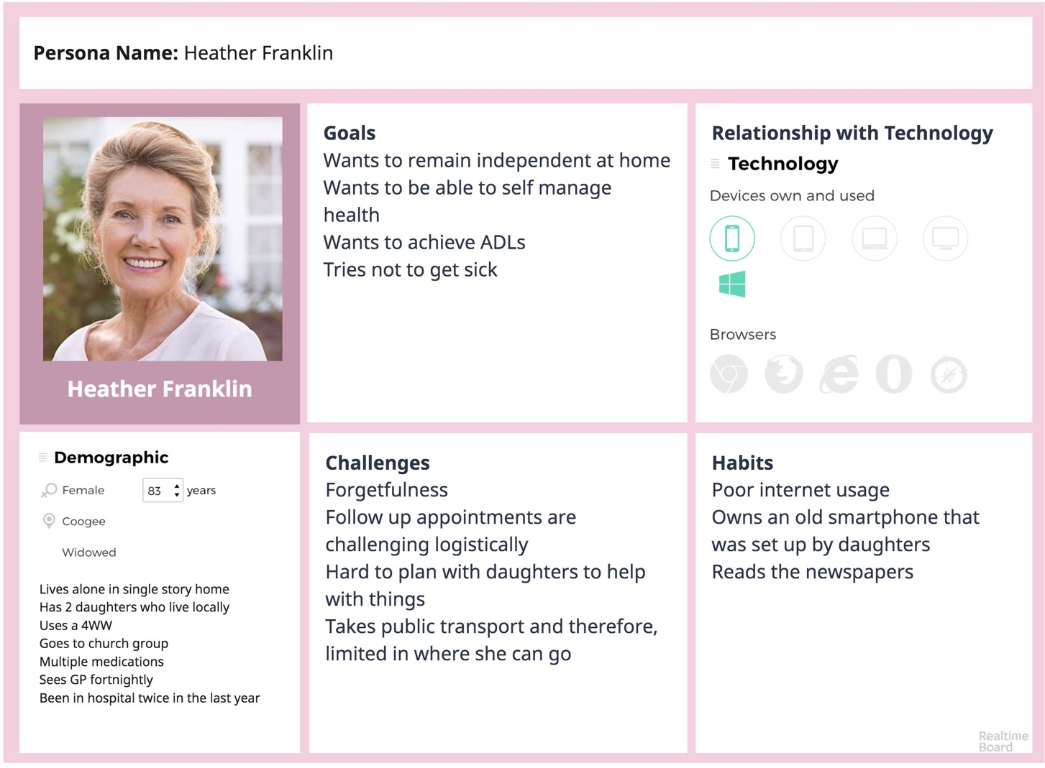
Patient Personas
Kristen Conventional
Kristen Conventional

Slide 24
Patient Acquisition/Retention
When we see and market to patients as the individuals they are, they’ll feel as though you’re speaking directly to them
Personalized marketing feels more authentic, builds trust and ultimately saves your organization wasted marketing dollars

Slide 25
Patient Acquisition/Retention
So, how do you begin to build a relationship with a patient you don’t know yet?
This can be achieved by utilizing:
• Behavior-based triggers
• In-market audiences
• Demographic & psychographic information
Remember: It’s just as important to retain your existing patient base; keep the patient experience in mind as you outline your strategy

Slide 26
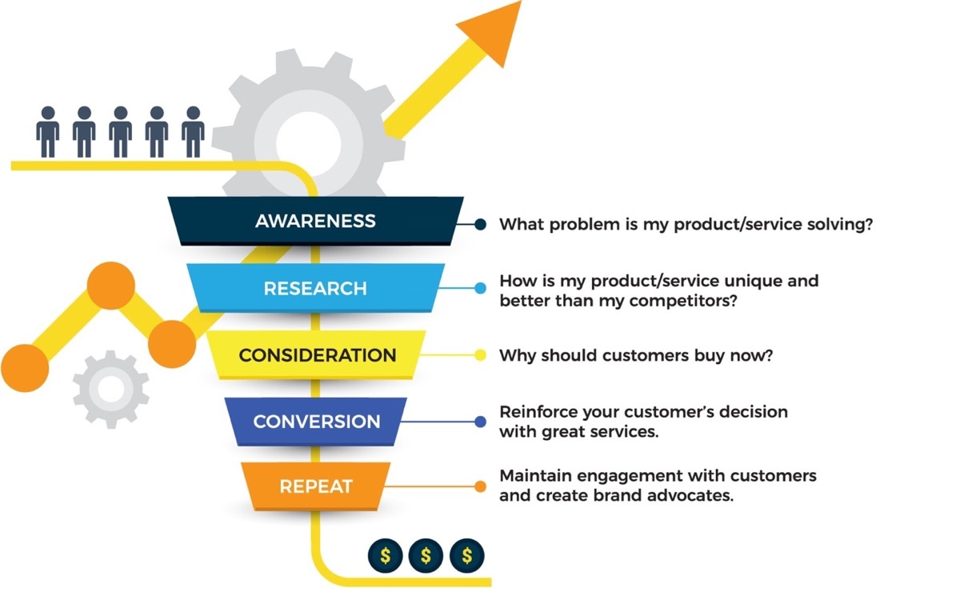

Slide 27
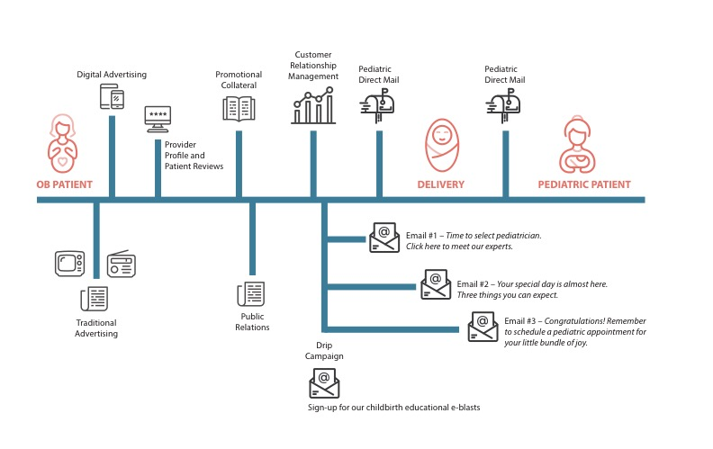
The Patient Journey

Slide 28

Strategy (Baseline KPIs & Planning)

Slide 29
Strategy (Baseline KPIs & Planning)
The important steps when using data in every aspect of your marketing strategy
Consumer research and market analysis
Campaign development and implementation
Measuring success and informing future decisions

Slide 30

Strategy: Upfront Research Data
Market research data
Begin by looking at people, numbers, and data
In partnership with Eide Bailly, we first assess:
Your patient base
Their healthcare needs and trends in the market area
The projected demographic changes (growing, shrinking, aging) as a basis for projecting service volumes.
Historical patient volumes
Competitive presence
Opportunities to meet the needs of service area residents

Slide 31

Strategy: Upfront Research Data
Define a primary service area (PSA)
With zip-code-specific inpatient, outpatient, and clinic patient volumes
Research process begins with by examining:
Population
Age
Income
Other demographic information

Slide 32
Strategy: Upfront Research Data
Market research deliverables utilizing Heath Care Advisory Board resources & tools
Market share
Market saturation of specialties and providers
Growth capacity to capture share of patients
Competitiveness
What is there, what is the demand, what’s feasible to capture
Align marketing budget with growth goals

Slide 33

Strategy: KPIs
Determine KPIs (Key Performance Indicators)
Organic traffic
Paid traffic
Patient volume
Revenue
New patient acquisition

Slide 34

Strategy: Measurement Tools
Measurement tools
Google Analytics
Google Ads
Google Business Listing
Google Search Console
Social Media Metrics
Google Trends

Slide 35
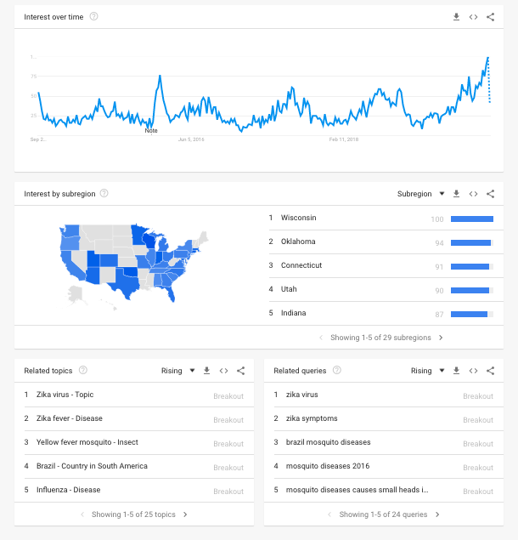

Slide 36

Strategy
Determine your strategy & channels:
Blogs
Social media
Emails (drip campaigns)
CTAs on website
Advanced content creation
Video
PPC
Traditional media

Slide 38

Analysis (Measurement &
Data-Driven Decision Making)

Slide 39

Analysis (Measurement & Data-Driven Decision Making)
Ongoing campaign data:
Determine time increments; compare KPI’s over previous period
Measurement objectives: 2 goals
Communication/engagement-based goals (more intangible)
Business Goals (more tangible: driving sales or market share)

Slide 40
Analysis (Measurement & Data-Driven Decision Making)
Measurement metrics
Business goals (i.e.: market share data, patient journey data)
Communication goals (i.e.: website activity, social media engagement, SEM performance, traditional media)
  Paid
  Organic
  Online reviews
  Social Media
  Earned media/PR

Slide 41
Legato ROI
Dashboard can be accessed at any time and uses BI software to generate real-time data from multiple channels aggregated into one dashboard
This reporting allows Legato to help clients make data-driven decisions
Metrics can then be measured against customer engagement in order to ascertain if changes were related
to marketing efforts

Slide 42
Legato ROI

Slide 43

Questions?

Slide 44

THANK YOU!
For more information contact:
920-544-8102
Legatohealthcaremarketing.com

